Slide 1


Kammavari Sangham (R) 1952, K.S.Group of Institutions
K S INSTITUTE OF TECHNOLOGY (Affiliated to VTU, Belagavi & Approved by AICTE, New Delhi, Accredited by NAAC &IEI)
DEPARTMENT OF COMPUTER SCIENCE AND ENGINEERING
Project work phase 1 (18CSP77)
“Face Mask Detection”
By Batch 2021_CSE_11
SUDHAKAR YASWANTH [ 1KS18CS101 ]
VINOD H MALALI [ 1KS18CS118 ]
PRATEEK HAVALE [ 1KS18CS070]
YASHWANTH K [ 1KS18CS121 ]
Under the Guidance of
Mrs. SOUGANDHIKA NARAYAN
Assistant professor
Dept. of CSE

Slide 2
CONTENTS
OVERVIEW
GOALS
APPLICATIONS
REQUIREMENTS
DATASET
REFERENCES

Slide 3
OVERVIEW
Coronavirus disease 2019 (COVID-19) has globally infected over 2.5 billion people causing over 5 million deaths.
Individuals with COVID-19 have had a wide scope of symptoms reported – serious illness.
Fever, dry cough, tiredness, loss of taste and smell are the major symptoms of coronavirus
Respiratory problems like difficulty in breathing.
Elder people having lung disease can possess serious complications from COVID-19 illness as they appear to be at higher risk.

Slide 4
OVERVIEW(cont….)
Many precautionary measures have been taken to fight against coronavirus. Among them cleaning hands, maintaining a safe distance and wearing a mask.
In order to protect ourselves from the COVID-19 Pandemic, almost every one of us to wear a face mask.
It becomes necessary to check if the people wear face mask in most public gatherings such as School, College, Malls etc.

Slide 5
GOALS
To detect whether a person is wearing a mask properly or not.
Detect mask with accuracy.
This method will also detect a face along with a mask in motion.
Plot the graph to check accuracy.

Slide 6
APPLICATIONS
Can be used in :
Schools
Colleges
Malls
Theaters
Hospitals

Slide 7
REQUIREMENTS
Operating system : Windows or Linux
IDE : Anaconda Navigator
Python Libraries
Images to train
Webcam
Language : Python

Slide 8
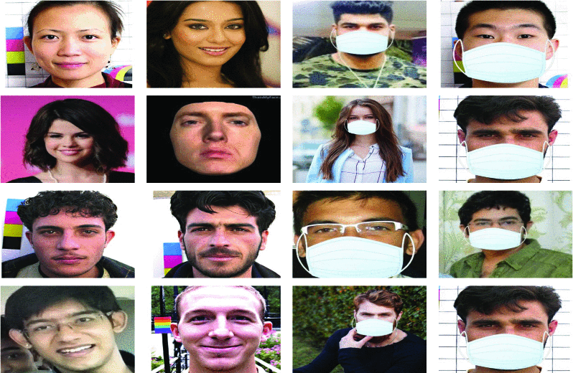
DATA SET
Two datasets will be used to implement.
Dataset will contain two types of data, Dataset 1 consists images with people wearing mask. Dataset 2 consists images with people who do not wear mask.

Slide 9
REFERENCES
https://www.kaggle.com/ashishjangra27/face-mask-12k-images-dataset
https://keras.io/api/preprocessing/image/#imagedatagenerator-class
https://www.tutorialspoint.com/tensorflow/index.htm
https://www.javatpoint.com/opencv
A. Das, M. Wasif Ansari and R. Basak, "Covid-19 Face Mask Detection Using TensorFlow, Keras and OpenCV," 2020 IEEE 17th India Council International Conference (INDICON), 2020, pp. 1-5, doi: 10.1109/INDICON49873.2020.9342585.

Slide 10
Thank you

